Slide 1

Yu Mi Kang, Nicholas A. Marston, Veronica J. Alexander, Thomas A. Prohaska, Xinhui Ran, Sabina A. Murphy, Erica L. Goodrich, Filipe A. Moura, Andre Zimerman, Elaine Waldman, Julia Weinland, Shuanglu Zhang,
Shuting Xia, Dan Li, Sotirios Tsimikas, Marc S. Sabatine, Robert P. Giugliano, Brian A. Bergmark
On Behalf of the CORE-TIMI 72a and CORE2-TIMI 72b Investigators
June 6, 2026
Notes:
10 min presentation; 5 min Q&A

Slide 2



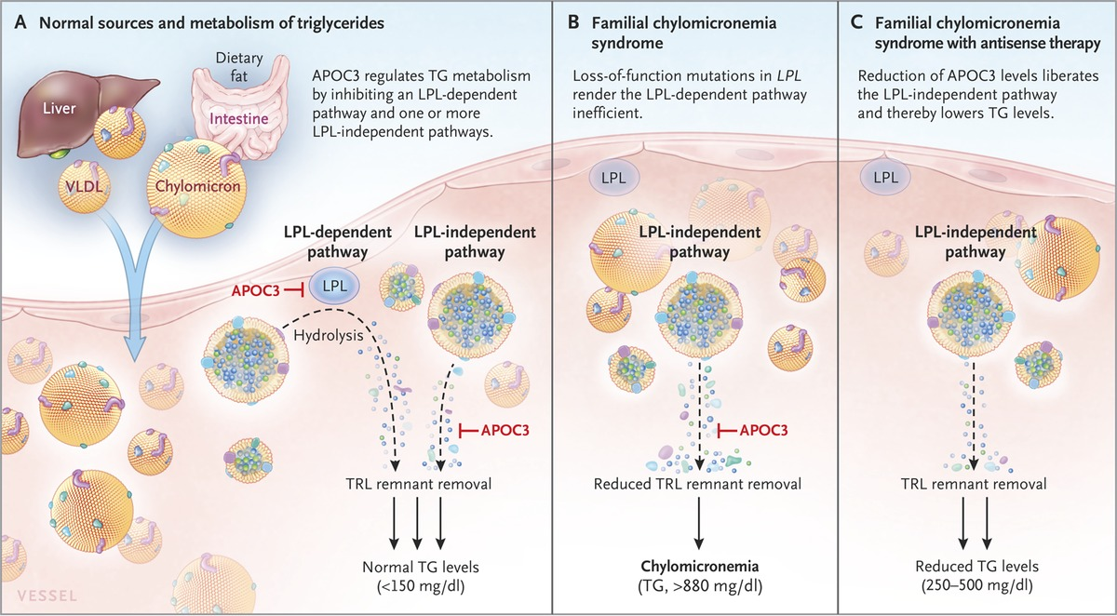
Background sHTG, APOC3, & olezarsen
Severe hypertriglyceridemia (sHTG), defined as triglycerides (TGs) ≥500 mg/dL (5.65 mmol/L) carries an increased risk of acute pancreatitis
Apolipoprotein C-III (APOC3) inhibits:
  lipoprotein lipase (LPL), a key enzyme in TG metabolism
  hepatic uptake of TG-rich lipoproteins (TRLs)
Olezarsen is an antisense oligonucleotide targeting APOC3 (i.e., APOC3 inhibitor)
Mach F, et al. Eur Heart J. 2020;41(1):111-188;
Gaudet, et al. N Engl J Med 2014;371:2200-2206.

Slide 3
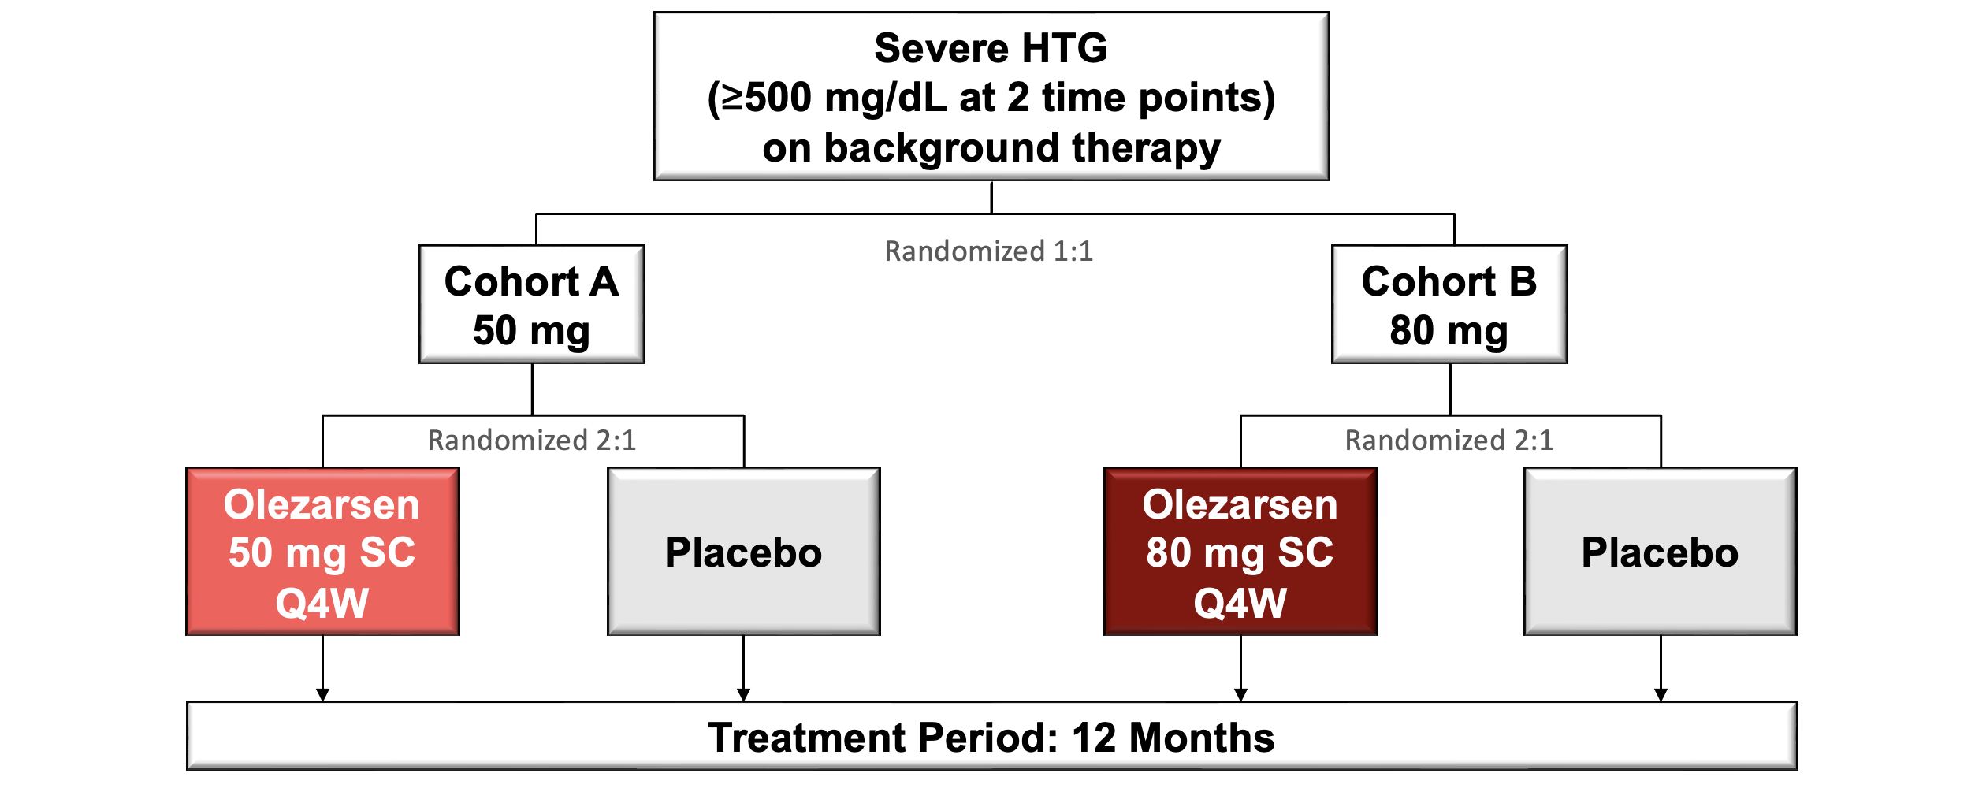
CORE–TIMI 72a & CORE2–TIMI 72b
Study design (identical)
Primary endpoint: placebo-adjusted % change in triglycerides at 6 months
Secondary endpoints include % change in other lipid parameters and acute pancreatitis
Marston NA, Bergmark BA et al. N Engl J Med 2026;394:429–441

Slide 4
CORE–TIMI 72a & CORE2–TIMI 72b
Primary endpoint: placebo-adjusted % change in TG at 6 months from baseline
CORE-TIMI 72a
CORE2-TIMI 72b
Olezarsen lowered plasma TG levels by ~49-72%, compared to placebo
Marston NA, Bergmark BA et al. N Engl J Med 2026;394:429–441

Slide 5
CORE–TIMI 72a & CORE2–TIMI 72b
Secondary endpoint: Acute pancreatitis over 12 months (pooled analysis)
Abbreviations: ARR, absolute risk reduction; NNT, number needed to treat; RR, rate ratio
Olezarsen reduced the rate of acute pancreatitis by 85%, compared to placebo
Marston NA, Bergmark BA et al. N Engl J Med 2026;394:429–441

Slide 6
Background & Objectives sHTG & DM
Insulin resistance, a hallmark of type 2 diabetes mellitus (DM), is a common non-genetic driver of TG dysregulation
Both sHTG & DM are independently associated with high risk for acute pancreatitis (AP), a potentially life-threatening complication
Therefore, patients with sHTG & DM represent a particularly high-risk subgroup
  Conventional TG-lowering therapies may not be sufficient to address the risk
We aimed to evaluate the efficacy & safety of olezarsen
in adults with sHTG & DM
Mechanick JI et al. J Am Coll Cardiol 2020;75:525–538
Girman CJ et al. Diabetes Obes Metab 2010;12:766–771

Slide 7
Methods
Modified intention-to-treat population (≥1 dose study medication)
Baseline DM was defined as at least one of:
  Investigator-reported history of DM (dedicated eCRF field)
  HbA1c ≥6.5%
  Use of glucose-lowering medications in the absence of a non-DM indication
Changes in fasting lipid and glycemic parameters at 6 months were assessed using an analysis of covariance (ANCOVA) model
Centrally adjudicated AP events over 12 months were compared between pooled olezarsen treatment and placebo groups using a negative binomial regression model

Slide 8
Baseline Characteristics
DM vs No DM
Characteristic | DM (N=689) | No DM (N=372)
Age (years) | 56 | 50
Female | 27.6% | 16.1%
Body mass index (kg/m²) | 31.6 | 30.3
History of ASCVD | 30.3% | 16.9%
History of pancreatitis | 21.5% | 14.0%
Lipid-lowering therapy
Statin | 80.0% | 62.6%
On ≥2 lipid-lowering therapy | 67.6% | 60.8%
Fasting laboratory results
Triglycerides (mg/dL) | 779.0 | 823.5
ApoC-III (mg/dL) | 35.2 | 32.9
eGFR (ml/min/1.73 m²) | 93.0 | 99.0
Characteristic | DM (N=689)
Glucose-lowering medications
Insulin | 36.0%
Basal insulin | 32.7%
Rapid-acting insulin | 22.1%
GLP-1 receptor agonist | 24.1%
DPP-4 inhibitor | 12.0%
Sulfonylureas | 20.8%
Meglitinides | 1.9%
Metformin | 80.0%
SGLT-2 inhibitor | 47.3%
Thiazolidinediones | 3.6%
All comparisons between subgroup had P<0.05 except baseline TG level
Continuous variables are presented as the median, and categorical variables are expressed as proportions (%)

Slide 9
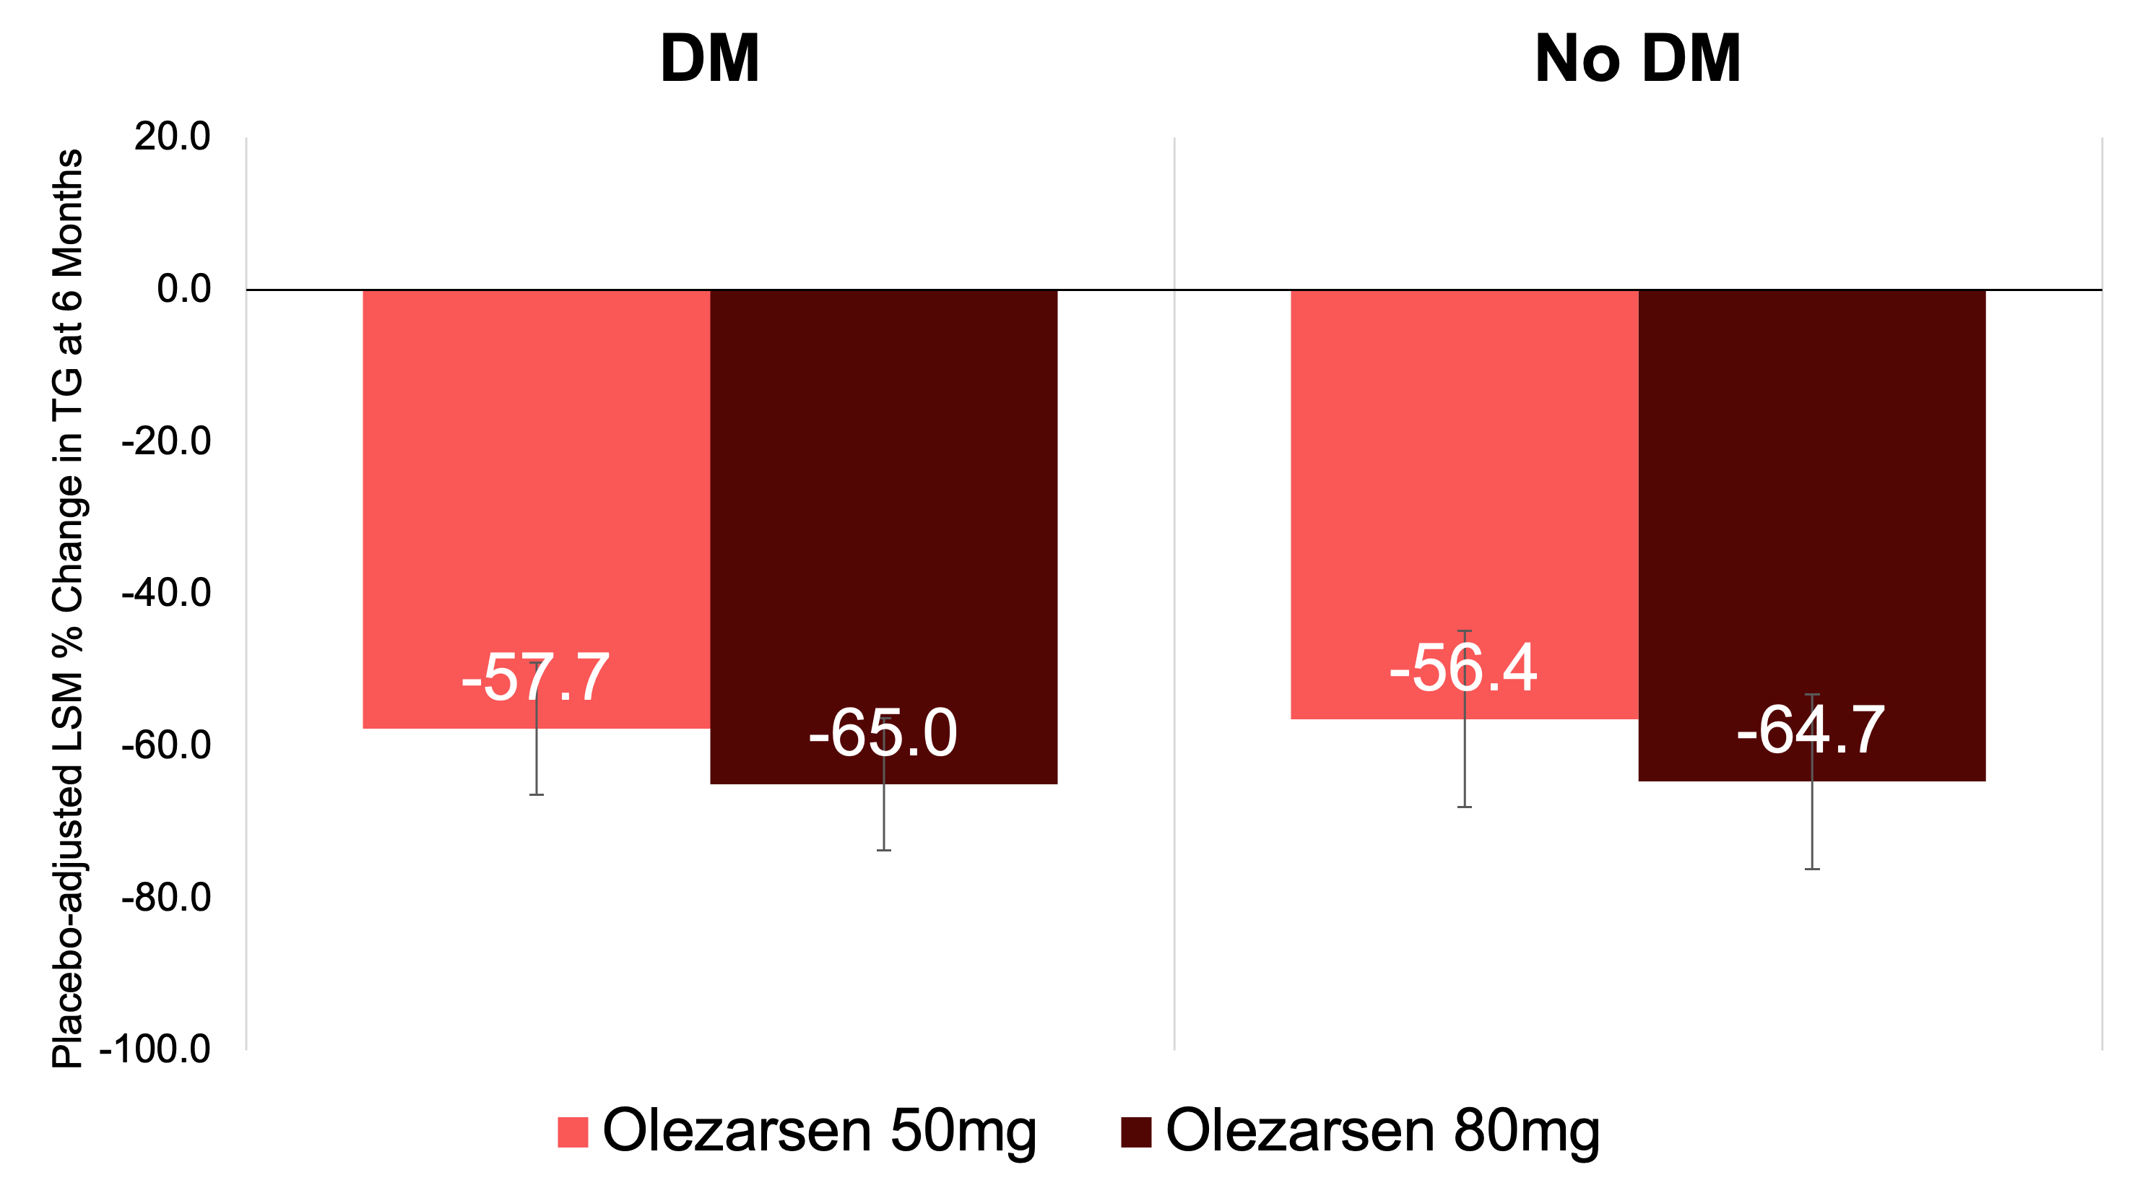
TG-Lowering Efficacy of Olezarsen by Baseline DM
At 6 months
Error bars indicate 95% confidence intervals; P<0.0001 for all comparisons vs. placebo; P-interaction=0.93

Slide 10
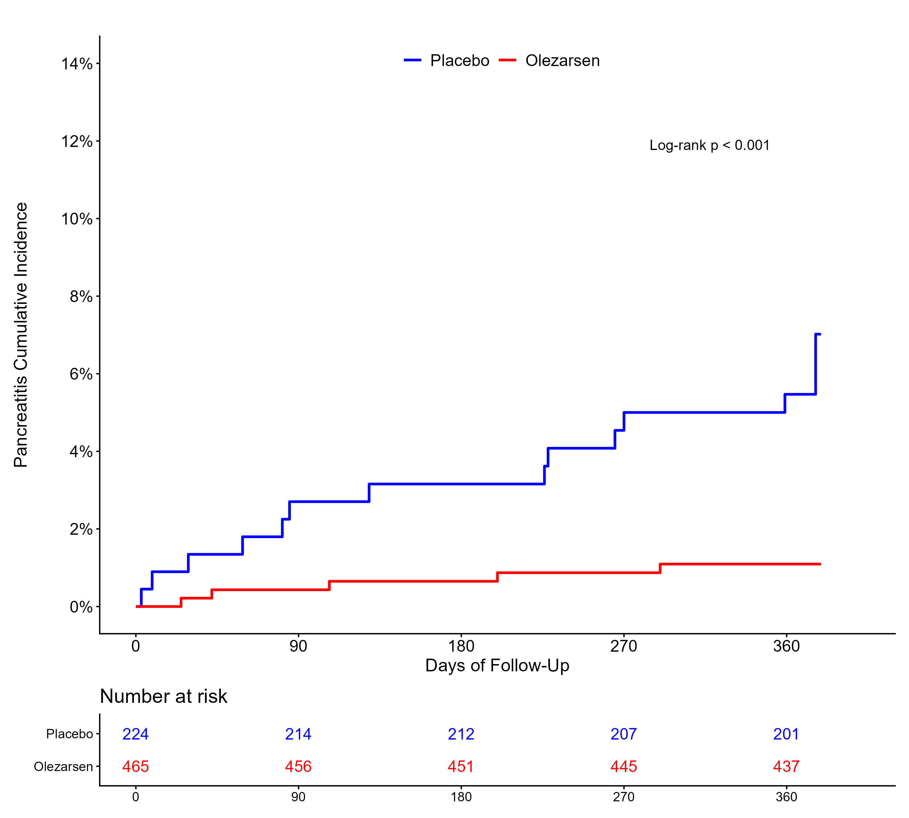
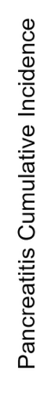
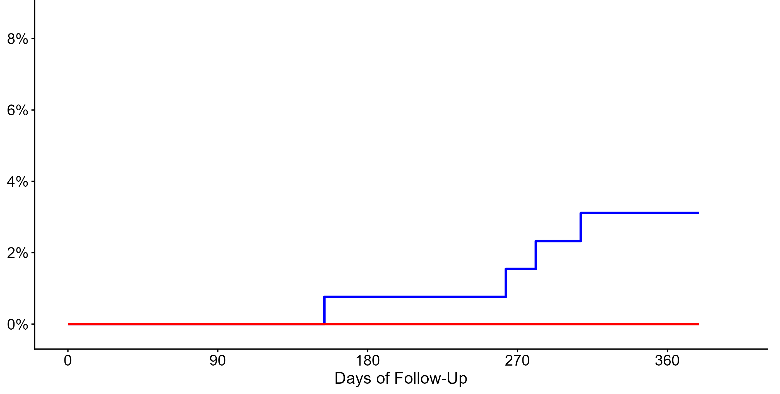
Efficacy of Olezarsen in Acute Pancreatitis Prevention
Total event analysis over 12 months, pooled olezarsen
DM
No DM
ARR = 6.6% (NNT = 16)
Rate ratio = 0.19 (0.07-0.56), P<0.001
ARR = 3.0% (NNT = 33)
Rate ratio = N/A
Abbreviations: ARR, absolute rate reduction; CI, confidence interval; NNT, number needed to treat
P for log-rank <0.01 for both graphs

Slide 11
Glycemic Impact of Olezarsen by DM Status
HbA1c, pooled olezarsen
Placebo (PBO)
Olezarsen
DM
PBO-adjusted LSM 𝚫:
0.26% (95% CI 0.10-0.43)*
No DM
PBO-adjusted LSM 𝚫:
0.13% (95% CI 0.07-0.19)*
Estimates at each time point are presented as medians, with error bars indicating 95% confidence intervals; *P<0.01
Abbreviation: LSM, least-squares mean; PEP, primary endpoint; PBO, placebo

Slide 12
Glycemic Impact of Olezarsen by DM Status
Fasting plasma glucose, pooled olezarsen
Placebo (PBO)
Olezarsen
PBO-adjusted LSM 𝚫:
12.1 mg/dL (95% CI 2.9-21.3)*
DM
No DM
PBO-adjusted LSM 𝚫 :
2.2 mg/dL (95% CI -1.1-5.6);
P=NS
Estimates at each time point are presented as medians, with error bars indicating 95% confidence intervals; *P<0.01
Abbreviation: LSM, least-squares mean; PEP, primary endpoint; PBO, placebo

Slide 13
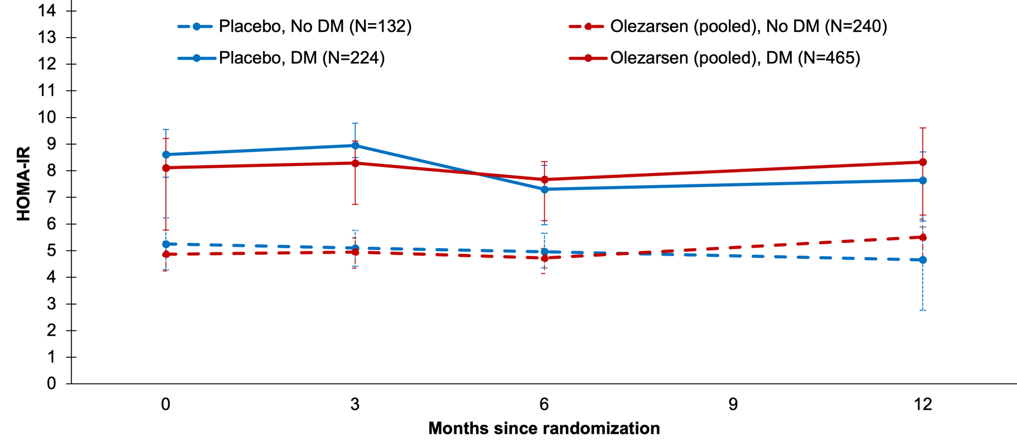
Glycemic Impact of Olezarsen by DM Status
HOMA-IR, pooled olezarsen
Placebo (PBO)
Olezarsen
PBO-adjusted LSM 𝚫:
1.5 (95% CI -0.6-3.6); P=NS
DM
No DM
PBO-adjusted LSM 𝚫:
-0.8 (95% CI -2.3-0.8); P=NS
Estimates at each time point are presented as medians, with error bars indicating 95% confidence intervals
Abbreviation: LSM, least-squares mean; PEP, primary endpoint; PBO, placebo

Slide 14
Limitations
Changes in diabetes medications were not assessed in this study
  Assessment of glycemic profile may not fully capture the extent of dysglycemia
Not designed to elucidate the mechanistic pathways underlying the glycemic change, but appears to be a class effect
Assessment of glycemic impact of olezarsen beyond 12 months requires further studies

Slide 15
Summary & Conclusions
In this high-risk population with severe HTG & DM, olezarsen;
  Reduced TG levels by 58–65% on top of currently available lipid lowering therapies
  Reduced acute pancreatitis events by 81%, with an absolute rate reduction of 6.6%
    Yielded a number needed to treat of 16 to prevent one event over 12 months
  Minimally increased HbA1c (by 0.26%) with no changes in HOMA-IR
    The degree of glycemic excursion observed is unlikely to be clinically meaningful for most sHTG patients
CORE-OLE (NCT05681351), an open-label extension study of CORE-TIMI 72a & CORE2-TIMI 72b, will further elucidate the long-term effect of olezarsen
@TIMIStudyGroup; http://www.timi.org
ymkang@bwh.harvard.edu

