Slide 1




Long-term efficacy and safety of Olezarsen in patients with Severe Hypertriglyceridemia
Interim One-Year Results of the CORE Open Label Extension (OLE) - TIMI 72c
Robert P. Giugliano, Brian A. Bergmark, Veronica J. Alexander, Thomas A. Prohaska, Andrew Dibble, Elaine Waldman, Shirley Li, Angel Soto-Hermida, Monika Nowosiad Magda, Phillippe Moulin, Erik Stroes, Ulf Landmesser, Sotirios Tsimikas, Marc S. Sabatine on behalf of the CORE-OLE Trial

Slide 2

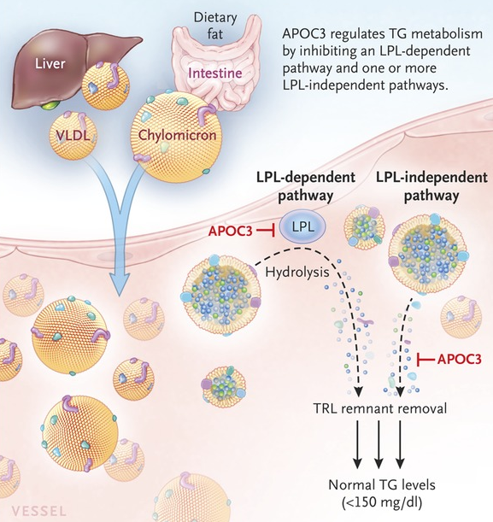
Background
Severe hypertriglyceridemia (sHTG), defined as triglycerides (TGs) of 500 mg/dL (5.65 mmol/L) or greater, carries an increased risk of acute pancreatitis
Apolipoprotein C-III (APOC3) inhibits:
    lipoprotein lipase, a key enzyme in TG metabolism
    hepatic uptake of TG-rich lipoproteins (TRLs)
Olezarsen is an antisense oligonucleotide targeting APOC3 that promotes the breakdown and clearance of TRLs, has demonstrated significant reduction in TGs and the risk of acute pancreatitis.
Olezarsen is approved in the EU and US for treatment of Familial Chylomicronemia Syndrome (FCS) and in the US in patients with severe hypertriglyceridemia to reduce triglyceride levels and the risk of acute pancreatitis
Gaudet D. N Engl J Med. 2014;371:2200-6
Marston NA, et al. N Engl J Med. 2026;394:429-441

Slide 3
CORE-TIMI 72a & CORE2-TIMI 72b
Identically designed
Severe HTG
(>500 mg/dL at 2 time points
on background therapy
(N=1061)
Randomized 1:1:1
Placebo
(N=356)
Olezarsen
50 mg SC
Q4W
(N=354)
Olezarsen
80 mg SC
Q4W
(N=351)
RCT Treatment Period 12 months
Primary endpoint: placebo-adjusted % change in triglycerides at 6 months
Secondary endpoints include % change in other lipid parameters and acute pancreatitis
CORE-OLE
Olezarsen 80 mg Q4W
2 trials performed in accordance with regulatory guidance
PEP, primary endpoint; SEP, secondary endpoint
Marston NA et al. Am Heart J. 2025;286:125-35

Slide 4
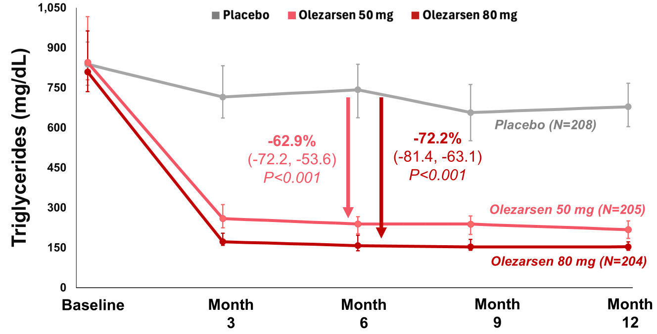
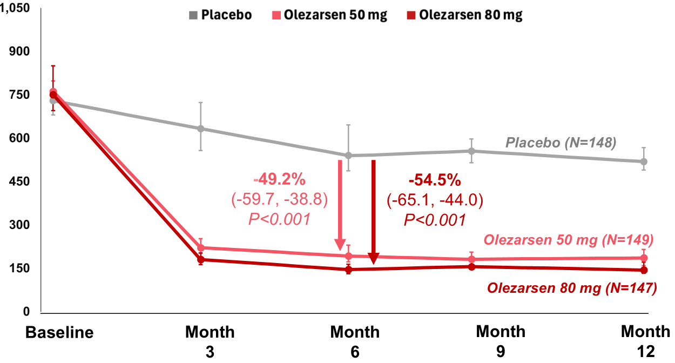
Primary Endpoint: CORE-TIMI 72A and 72B
CORE-TIMI 72A
CORE2-TIMI 72B
-62.9%
-72.2%
-49.2%
-54.5%
Among patients with severe hypertriglyceridemia, olezarsen:
  Lowered triglycerides by up to 72% c/w placebo on top of conventional therapies
  Resulted in >85% of patients achieving TG levels below 500 mg/dL
Marston NA, et al. N Engl J Med. 2026;394(5):429-41

Slide 5
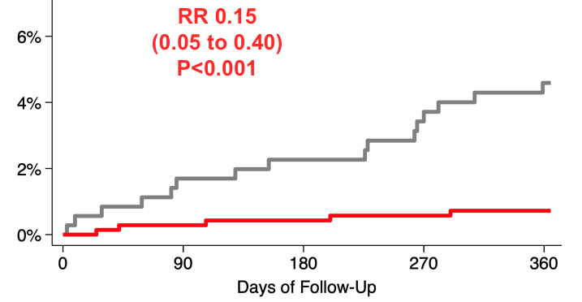

Acute Pancreatitis
Pooled analysis across both trials and doses
Placebo (n=356)
Olezarsen (n=705)
ARR in incidence of total events
= 5.2%
NNT over 1 year
= 20
Pancreatitis Cumulative Incidence
ARR, Absolute Risk Reduction
Marston NA, et al. N Engl J Med. 2026;394(5):429-41

Slide 6
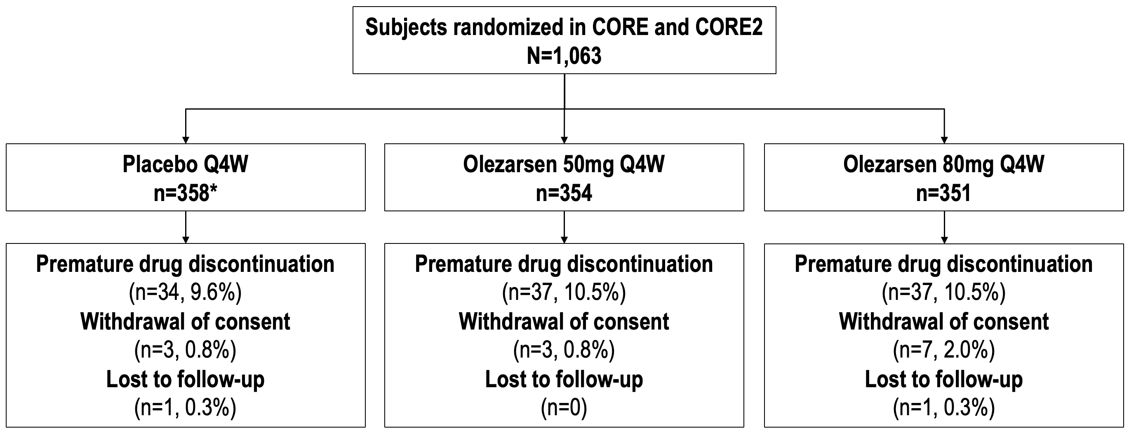
Patient Disposition
CORE-TIMI 72a & CORE2-TIMI 72b -> CORE OLE
Primary EP (Safety):
plt count, bleeding, Δ eGFR, urine microalb, LFTs
Secondary EP (Efficacy):
Δ lipids, acute pancreatitis
Exploratory EP:
measures of glycemia, hepatic fat
Year 0-1
n=296*
n=298
n=291
CORE-OLE
Olezarsen 80 mg Q4W
n=885
Planned duration > 2 yrs of OLE
Rx compliance 98% at 10 months (IQR 6-13 mths)
Years 1-3+
*1 patient in placebo arm did not receive olezarsen in OLE

Slide 7
Baseline characteristics OF OLE Population at Randomization into PARENT RCTs
Age (yrs) | 54 [46, 61]
Female sex | 23%
Race/Ethnicity
White | 89%
Hispanic/Latino | 12%
Body Mass Index (kg/m²) | 31 [28,35]
Diabetes mellitus | 64%
Triglycerides (mg/dL) | 798 [593,1277]
History of Pancreatitis | 16%
Any Lipid Lowering Therapy | 99%
Statin | 75%
Fibrate | 63%
Omega-3 fatty acid | 32%
At time of entry into OLE
Placebo 611 [418, 1163]
Ole 50 mg 199 [127,336]
Ole 80 mg 149 [103, 311]
Continuous variables shown as median [IQR] Baseline variables balanced by treatment arm
Preliminary data

Slide 8
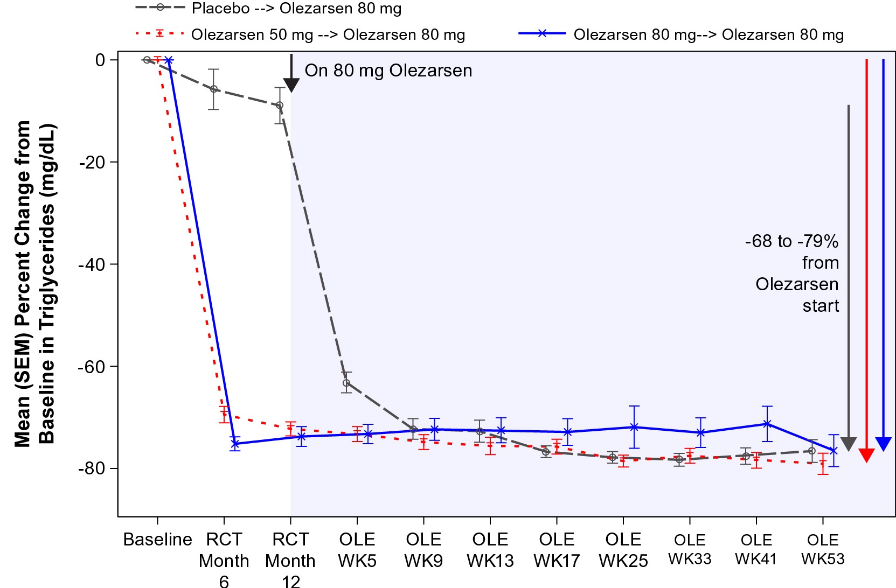
Mean % Change IN baseline* Triglycerides through ole Week 53
Achieved TGs at OLE Week 53
Median [IQR] 135 [90, 250]
<500 mg/dL 90%
<150 mg/dL 58%
I-----RCT----I------------------Open Label Extension-------------------
*Baseline prior to start of CORE-TIMI 72a and CORE-TIMI 72b Error bars show the standard error of the mean
Preliminary data

Slide 9
Secondary Lipid Endpoints
Mean % Changes from RCT Baseline
Apolipoprotein C-III
VLDL-Cholesterol
Placebo--> Ole 80
Ole 50 --> Ole 80
x
Ole 80 --> Ole 80
At OLE Week 53
Δ -87% (-91,-79)
At OLE Week 53
Δ -78% (-85,-67)
Non-HDL-Cholesterol
Apolipoprotein B
At OLE Week 53
Δ -38% (-56,-19)
At OLE Week 53
Δ -12% (-30,+3)
Preliminary data

Slide 10
Primary Endpoints (Safety)
 | CORE-TIMI 72a & CORE2-TIMI 72b (pooled, N=1,061) |  |  | CORE-OLE
 | Placebo (N=356) | Olezarsen 50 mg (N=354) | Olezarsen 80 mg (N=351) | Olezarsen 80 mg (n=884*)
Platelet count <75K/uL | 1.7 | 0.6 | 2.0 | 0.9
Clinical bleeding events | 4.8 | 5.9 | 5.4 | 3.5
Decrease in eGFR > 30% | 13.4 | 8.9 | 10.1 | 6.2
Decrease in eGFR > 50% | 2.0 | 0.9 | 2.9 | 0.8
UPCR > 500 mg/g | 14.2 | 12.1 | 13.6 | 8.6
UPCR > 1000 mg/g | 4.5 | 5.2 | 4.0 | 2.8
ALT or AST > 5x ULN | 0.9 | 0.9 | 1.4 | 0.5
Total bilirubin > 2.0 mg/dL | 0.3 | 0.3 | 0.6 | 0.3
*Excludes 1 patient enrolled in the OLE did not take any doses of olezarsen
Data shown are n/N rates
No cases of Hy’s Law (AST or ALT >3x ULN and total bilirubin > 2x ULN) were observed
NOTE: Rates shown for CORE-TIMI 72a and CORE2-TIMI 72b data are at 1 year, for CORE-OLE through median 10 months follow-up.
Preliminary data

Slide 11
Adverse events
 | CORE-TIMI 72a & CORE2-TIMI 72b (pooled N=1,061) |  |  | CORE-OLE
 | Placebo (N=356) | Olezarsen 50 mg (N=354) | Olezarsen 80 mg (N=351) | Olezarsen 80 mg (N=884*)
Any treatment emergent adverse event | 75.0 | 74.6 | 76.1 | 60.7
Leading to drug discontinuation | 2.0 | 3.4 | 4.3 | 3.3
Serious | 13.8 | 8.8 | 10.8 | 8.5
Leading to drug discontinuation | 0.3 | 1.1 | 0.6 | 1.5
Injection site reactions
Any | 0.8 | 10.2 | 16.5 | 11.4
Mild | 0.8 | 9.6 | 14.8 | 10.3
Moderate | 0 | 1.1 | 2.8 | 1.1
Severe | 0 | 0 | 0 | 0
*Excludes 1 patient enrolled in the OLE did not take any doses of olezarsen
Data shown are n/N rates
NOTE: Rates shown for CORE-TIMI 72a and CORE2-TIMI 72b data are at 1 year, for CORE-OLE through median 10 months follow-up.
Preliminary data

Slide 12
Adjudicated cases of
acute pancreatitis
 | CORE-TIMI 72a & CORE2 TIMI-72b (pooled RCTs) |  | CORE-OLE
 | All Olezarsen (N=705) | Placebo (N=356) | Olezarsen 80 mg (N=884)
Patients with an event, n(%) | 5 (0.7) | 17 (4.8) | 10 (1.1)
Total number of events | 7 | 22 | 19*
Total patient-years | 696.1 | 352.9 | 711.4
Event rate per 100 pt/yr | 1.01 | 6.23 | 2.67
*1 non-compliant patient had 8 events
Preliminary data

Slide 13
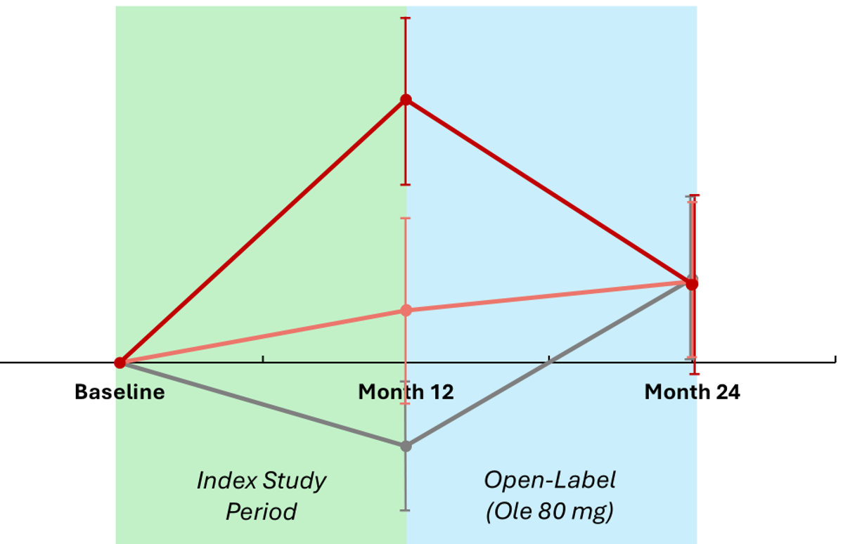
MRI Hepatic Fat Substudy
Preliminary 24-month data (n=53)
(n=13)
(n=16)
(n=24)
LSM Absolute Change
in Hepatic Fat Fraction (%)
Index Study
Period
HFF = hepatic fat fraction
Baseline HFF = 13.9% in placebo, 17.6% in 50 mg, 16.0% in 80 mg
Preliminary data

Slide 14
Summary & conclusion
In patients with severe hypertriglyceridemia (TG >500 mg/dL), longer term use of olezarsen for up to 2 years:
  Was generally well tolerated, with no new safety findings
  Sustained TG lowering of 68-79%
  Resulted in 90% of patients achieving TG levels <500 mg/dL
  Achieved persistent reductions in the risk of acute pancreatitis
  Preliminary data suggest only modest (<2%) ↑ in hepatic fat fraction through 2 years
These findings provide additional support for the continued use of olezarsen in patients with severe hypertriglyceridemia to reduce triglyceride levels and risk of acute pancreatitis over the longer term

